Slide 1
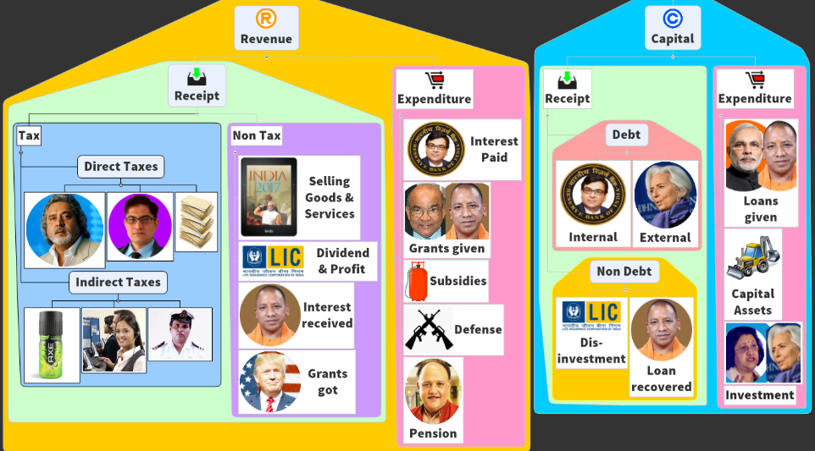
BES172: Budget ► Revenue ► Receipt ► Tax
Goods & Services Tax
Black Money & Demonetization
PPT Focus: Objective, factual. Not “analysis” for mains

Slide 2
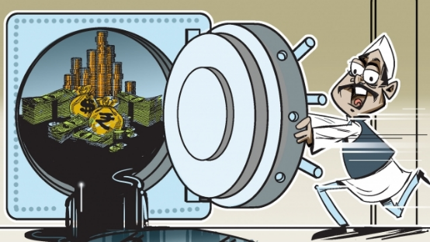
Recent Acts & Schemes
Tax Admin: TDS, TCS,
Demonetization helped or not?
CGT: root of many problems
BEPS, AEoI
PoEM, GAAR [WEF1/4/17], AAR
Electoral-Bonds
Black Money & Demonetization
PPT Focus: Objective, factual. Not “analysis” for mains

Slide 3
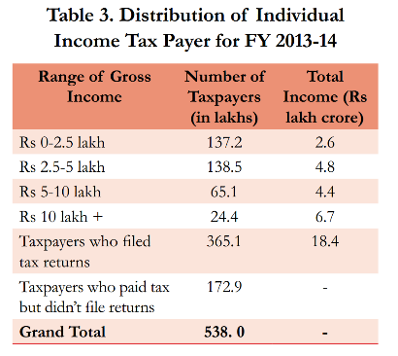
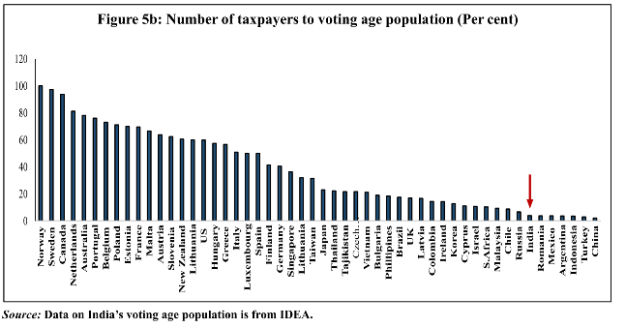
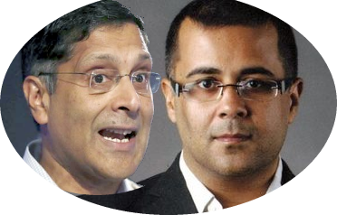
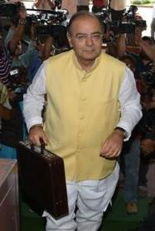
Only 4% of Indian voters are tax payers (ideal 23%)
We need to improve our fiscal capacity
<BES162 Link>
~5 cr. Indians pay income tax.
Last year
This year
~17% (Tax: GDP) low [based on income, consumption data]
Direct: indirect tax ratio not right. 1st world DT >> IT
Tax Non-compliant society. So honest have to bear burden.

Slide 4
Black Money: Amount of income or transaction not disclosed to the tax authorities. It can be generated from legal activities (e.g. business) or illegal (e.g. bribery, ransom, narcotics, betting, gambling)
Direct tax:
Indirect tax
Income, Expenditure, Capital Assets
Mfg & Sale of Goods & Services incl. import & export.

Slide 5
Black Money Stored in Cash of Rs. 500 & 1000
SBN Cession of Liability Act 2017 <Lecture>
Black Money Stored in Assets
Benami Assets?
Foreign Assets?
Black money stored in cash / assets
Tax laws
Public Officials: PCA Act ’88
PMLA Act: 2002 <Black2White>
List not Exhaustive

Slide 6

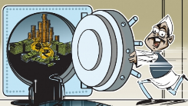
Benami Transaction Act
Black money
1988-> amended 2016
“Benami” = holding property in other person’s name. (driver, wife, relative etc.). E.g. Lalu’s daughter under probe.
Penalty: 7 years jail + upto 25% of market value of property.
Income tax dept will seize
Appellate tribunal (Chairman + 2 member)- finish case in 1 year.

Slide 7


Foreign assets
Black Money
Hiding Foreign assets or income.
Undisclosed Foreign Income and Assets (Imposition of Tax) Act, 2015
30% tax + penalty
Company officials (CA, Account, Company Secretary) etc. liable.
Bank, NBFC abetting – also liable.

Slide 8
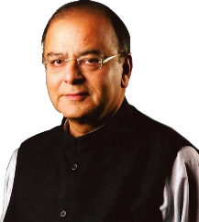
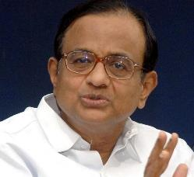
Tax Amnesty Scheme vs. income disclosure scheme
10%
20%
30%
7.5% Penalty
7.5% Surcharge
45% TAX
Income declaration scheme (2016)
June 1 to Sep 30
Rajiv Gandhi Black money declare kardo yojana
VDIS (1997)
Pay highest slab
10% Penalty
33% Surcharge
50% TAX
Then PIL in SC,
So Government assured no ‘amnesty’ in future
PM Garib Kalyan Yojana
Taxation Laws Second (Amendment) Bill, 2016. WEF 17th December

Slide 9

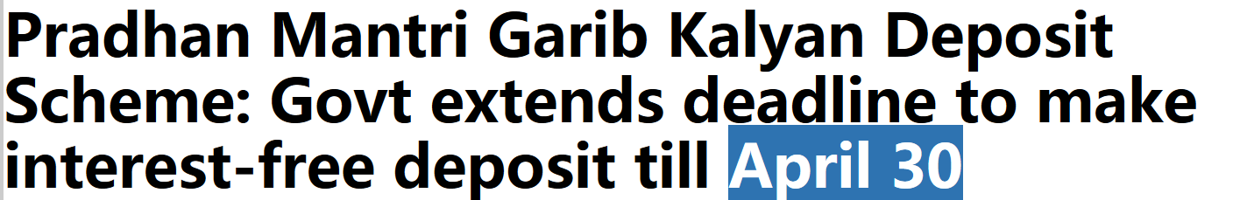
PM Garib Kalyan Yojana (else 77.25% + JAIL)
Black Money 100 Cr.
50 cr.
25 cr.
25 cr.
Gone in
TAX + Penalty
Any Commercial Banks-> E-Kuber -> RBI’s “Bond ledger” ->(Public Account)
Savings cert without interest
4 years lock in [if dead, nominee]

Slide 10
Recent Acts & Schemes
Tax Admin: TDS, TCS,
Demonetization helped or not?
CGT: root of many problems
BEPS, AEoI
PoEM, GAAR [WEF1/4/17], AAR
Electoral-Bonds

Slide 11
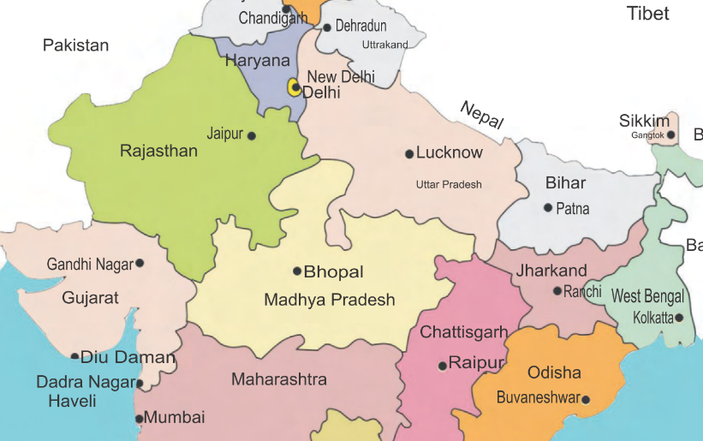




Capital Gains tax: direct tax on profit made from sale of assets
Short term 15%
Long term 20%
How long I held the asset before selling?
Threshold: 1-3 years | type
WITHHOLD CGT
& Pay to Govt.

Slide 12
CGT Problem: Penny stock scam: <no PhD /CA>
If shares held for >1 year, then sold, then no long term capital gains tax.
Shell companies: shares issues Rs.10.
After 1 year, rig the prices to Rs. 40 via circular trading/ private placement.
Sell it, to launder money. i.e. Jetha gives me my black money (after cutting commission).
<more in this link>
2017: SENSEX crossed 30k, SEBI warned people not to invest in penny stocks. They’re under investigation.
Pay money
Sell Shares
+ cut CGT & pay to Government

Slide 13
CGT Problem#2: Round Tripping: <no PhD /CA>
CGT applicable is Indian individual / firms.
But if Mauritius firms investing in India, only their Government can levy CGT. (Under DTAA).
But Mauritius eliminated CGT.
Now, I create shell firm in Mauritius, & Invest in Indian shares. <“round tripping”.>
Then sell to Jetha @Profit = no CGT applicable.
Solution: Amended DTAA, India to begin charging CGT in gradual manner from 2016-20.
Pay money
Sell Shares
+ cut CGT & pay to Government

Slide 14
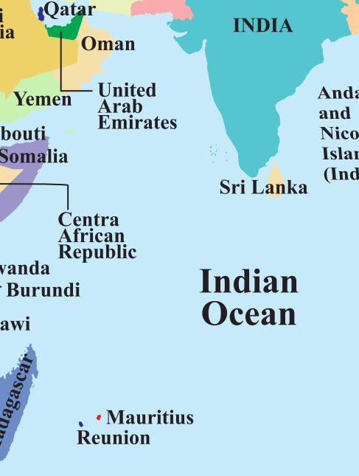
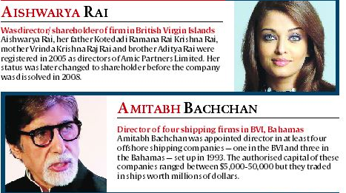
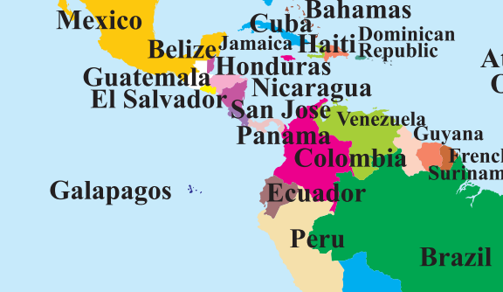

2016: “Panama Papers” leak. More on Indianexpress
Law firm that helped Indians to create shell firms in tax havens. Data leaked. “Panama Papers”

Slide 15
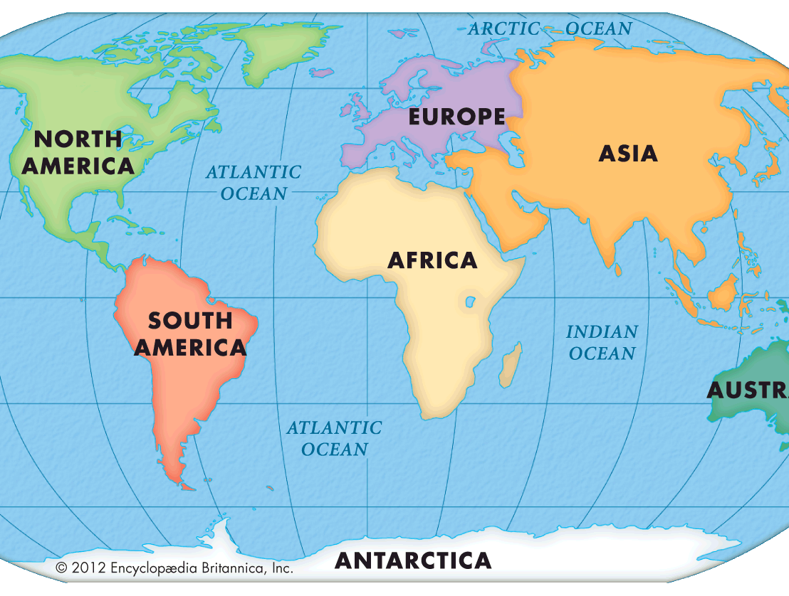
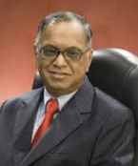

Place of Effective Management (PoEM)
India can tax this income
(40% Corporation Tax on foreign co’s profit)
Wallmart Inc.
USA
Walmart India
Infosys, India
India can’t tax this income.
Infosys royalty from Brazil, we can tax, because incorporated under Indian companies act
Walmart, BR.
If Indian person’s opens Bahama “shipping” company.
India can also demand tax on its profits. Because place of effective management is “Indian’s person’s Indian office!”

Slide 16
Place of Effective Management (PoEM) WEF 1/4/17
2017
1st april se effective
Jan: CBDT issued Guidelines
2015
Finance Act: PoEM
If place of effective management is India
Then India can tax is Indian income and Global income. Including global passive income e.g. “royalties”
Parameters to determine PoEM
Where are management and commercial decision taken?
BoD location? tech. used in their meetings?
if BoD delegated powers to another Executive panel- their location?
From where its royalty, dividend, capital gains, interest or rental income coming? (aka Passive income).
% of total assets and % of total employees located in India.

Slide 17
Recent Acts & Schemes
Tax Admin: TDS, TCS,
Demonetization helped or not?
CGT: root of many problems
BEPS, AEoI
PoEM, GAAR [WEF1/4/17], AAR
Electoral-Bonds

Slide 18


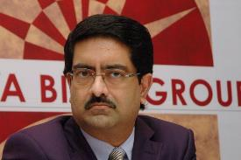

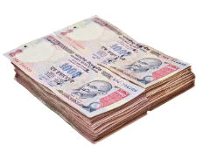
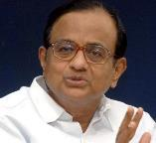
CGT Problem: During sale / merger of companies: <no PhD /CA>
1000 Crore
900 cr.
Kishor Biyani
Future Group
Kumar Manglam
Birla
CGT
100 Crore
TDS
Withholding TAX
Pantaloon
Pantaloon
Notes:
TDS at Source; actually Pranab Mukharjee

Slide 19





Vodafone PLC, London
Hutchinson HongKong
$ 11 bn
Rs. 55k cr
Vodafone, Netherland
CGP investment Holding, Cayman
Hutch Essar, India
Vodafone India
Feb. 2007
Notes:
Hutch Essar’s 67% stakes held by CGP investment ltd.

Slide 20
Deal happened outside India,
We purchase Cayman co. not Indian company, so you’ve no jurisdiction!
Vodafone PLC, London
Hutchinson HongKong
55-12=43
Vodafone, Netherland
CGP investment Holding, Cayman
12k Crore
Hutch Essar, India
Vodafone Essar India
Mar. 2007
Cayman island co. derives its value from Indian assets, so we can demand tax!
Notes:
TDS at Source; actually Pranab Mukharjee

Slide 21

Capital Gains Tax on sale/purchase of companies.
Tax avoidance
Capital Gain Tax Avoidance: when Vodafone bought Hutchison’s India business, via indirect-purchase of Cayman island “post-box” company.
SC: out of jurisdiction [avoidance]
UPA Government amendment IT act to demand tax with “retrospective effect”.
Vodafone approached international arbitration under India- Netherlands bilateral investment treaty [ball by ball]

Slide 22
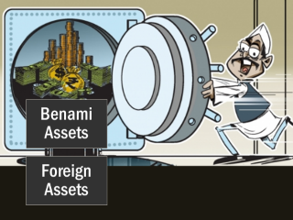
Understand the difference
Tax Evasion
Tax Avoidance (Vodafone)
Income / transaction hidden
Black money
Jailtime
Reported, everything on file
But Legal loopholes used to avoid tax
Black money….?
Vodafone CGT, Nokia- Royalty

Slide 23
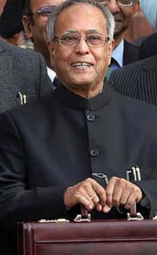
GAAR
Budget 2012
General Anti Avoidance Rules
WEF 1/4/2014 [1/4/17]
IT commissioner take action against tax avoidance
Indian Citizen, NRI, Foreigner
Even outside India
Even retrospective
Even if protected under any DTAA

Slide 24
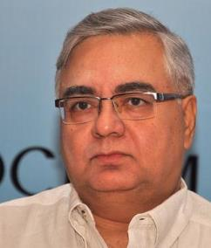
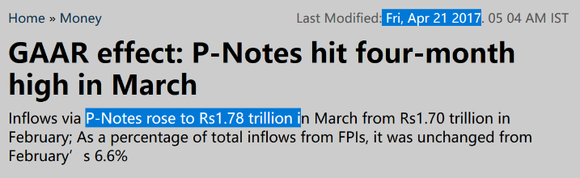
GAAR how to prevent abuse?
2012
Parthasarathi Shome Panel: Only in rare cases
>3 Cr. tax benefit [Not to fill Revenue shortfalls]
Defer till 2016. Jaitley => 1/4/2017 [and not retrospective]
Safeguard before notice: Princi. Commissioner + panel headed by HC judge.
Now if caught: Equities 15%, Derivatives 30% [+ penalty depending on facts & circumstances of the case.]
I’m also chief of Tax Administration Reform Commission (TARC)
2013-16

Slide 25









P-Note: Offshore Derivative Instrument
Offshore Investor
Without PAN card, DEMAD account
or SEBI Registration
Shares
bonds
SEBI registered
FII/FPI (India)
Tom can sell
P-note to others without paying capital gains tax
to India
P-Note
Derives value from
FII portfolio
FII’s portfolio
Notes:
March 2014: 2 lakh Crore (13% of FII)
Hot money
CGT evade
Anonymous (Quarterly records to SEBI)
terrorist money (Ex-NSA MK Narayan)
Money Laundering (FM Whitepaper)

Slide 26






P-Notes: round tripping, Terror Finance, Money Laundering…
Sadhu Yadav a.k.a Politician, builder, Contractor & Mafia
all in one Multiskill
Hawala operator sends Rupees to Tax Haven, converting
to Dollars
Hedge Fund Manager or Investment banker
in Tax Haven
SEBI registered FII
P-Note
Derives value from FII’s portfolio
FII’s portfolio

Slide 27
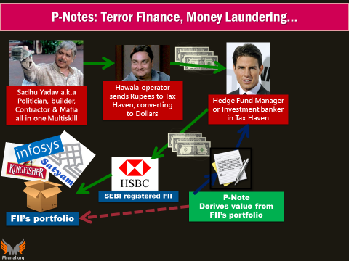

GAAR
Making deals outside India on Indian assets
P-Notes
Technical Escape, even caught less penalties.
Notice & 15-30% Tax.
CAT-1
e.g. US Government,
CAT-2
CAT-3
US’s LIC, EPFO etc.
Foreign MF, Pension Fund
Not in 1 or 2
Who can’t issue P-Notes
CAT-II high risk
CAT-III all
Notes:
FPI new classification
Risk profile + KYC compliance
CAT I: Foreign government, government's fin. Institutions (UTI, EPFO, LIC)
CAT II: Mutual Fund, Pension Fund, Univ.Fund,
CAT III: not in CAT I and CAT II (e.g. Hedge Funds)
Who can't issue P-notes?
CAT III
CAT II: certain high risk

Slide 28

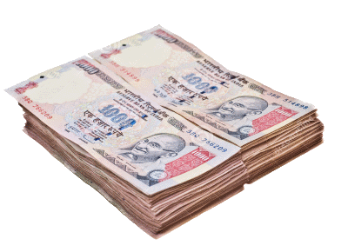
Transfer Pricing and Advance ruling?
Decides transfer price of shares
1000 cr. 100 Cr.
Kishor Biyani
Future Group
Big Bazaar
Pantaloon
CGT [▼]
UNDER-VALUATION
But why transfer shares?
MNC: Reduce Tax liability from foreign profits (Netherland=> Mauritius)
Transfer pricing: Vodafone (separate case) sell it @higher price.
Replace the Chain of command
Notes:
Real life – undervaluation

Slide 29


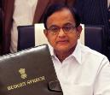
Why advance ruling on transfer pricing, M&A etc.?
Before the deal
Authority for Advance Ruling (AAR)
After deal
Litigation
IT Act, Statutory body, 93
Retd. Judge etc.
Both Indian and foreign companies can approach
Time limit , appeal streamline
Budget 2017: Merge: DT & iDT’s AARs

Slide 30
CGT -> GAAR-> ease of doing also.
Budget 2017
OECD Guidelines aligned. Will not harass companies.
More financial instruments exempted from CGT.
Andhra Pradesh: land acquisition for state capital…exempt.
Budget 2016
Startup companies, gold bonds, rupee denominated bonds…
Budgets
Notes:
No Capital gains Tax on Startup investors **
Sovereign gold bond; gold monetization scheme = ▼CAD
Merger of plans within mutual fund= retail participation
Rupee denominated bond of Indian company by non-resident-
No CGT on profit from currency appreciation.
=deepening of corporate bond market=▼Bank-NPA
We also plan to extend the basket of financial instruments in which the capital gains can be invested without payment of tax.
new capital for State of Andhra Pradesh is being constructed by innovative land-pooling mechanism without use of the Land Acquisition Act. I propose to exempt from capital gain tax, persons holding land on 2.6.2014, the date on which the State of Andhra Pradesh was reorganised, and whose land is being pooled for creation of capital city under the Government scheme.

Slide 31
Recent Acts & Schemes
Tax Admin: TDS, TCS,
Demonetization helped or not?
CGT: root of many problems
BEPS, AEoI
PoEM, GAAR [WEF1/4/17], AAR
Electoral-Bonds

Slide 32





Foreign company’s profit: 40% corporation Tax, but what if.. Base erosion and profit shifting (BEPS)
Foreign Parents
Fiscal imperialism
3rd world deprived of its tax income
Intermediate Holding Company
Costa Rica
BVI
Supply Chain Transaction
Developing Countries
Cayman
Bermuda
Interest transfer payments
Luxembourg
Lease transfer payments
TAX HAVEN
Royalty transfer payments
OECD: Base Erosion and Profit Shifting (Beps): Prevent companies from shifting profit to low-tax jurisdiction nations. Automatic Exchange of Information (AEOI)
FATF: Financial Action Task Force to combat money laundering and terrorist financing. Secretariat: Paris, provided by OECD

Slide 33
UPSC Prelim 2016
35. The term 'Base Erosion and Profit Shifting' is sometimes seen in the news in the context of
(a) mining operation by multinational companies in resource-rich but backward areas
(b) curbing of the tax evasion by multinational companies
(c) exploitation of genetic resources of a country by multinational companies
(d) lack of consideration of environmental costs in the planning and implementation of developmental projects.

Slide 34
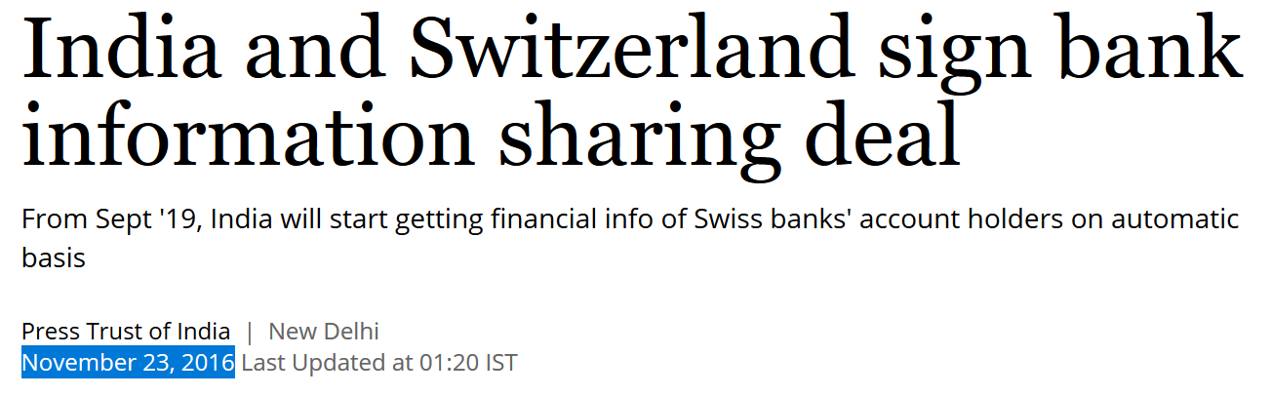
Information exchange agreements
FATCA
India: automatic exchange of information (AEIO)
FATCA
Foreign Account Tax Compliance Act (FATCA): Countries need to inform US- about investments of American taxpayers/companies.
But from September 2018 onwards
And only “new accounts!”

Slide 35
Recent Acts & Schemes
Tax Admin: TDS, TCS….
Demonetization helped or not?
CGT: root of many problems
BEPS, AEoI
PoEM, GAAR [WEF1/4/17], AAR
Electoral-Bonds

Slide 36
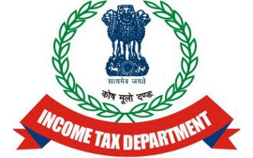
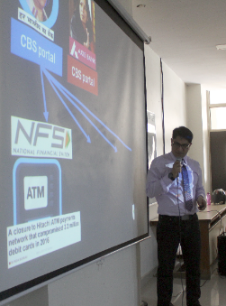
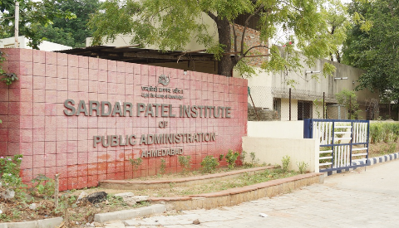
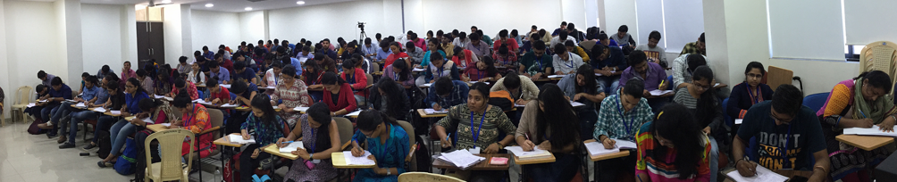
Suppose I’m to get Rs.1,000/- for delivering lecture
Tax evasion Difficult.
“liquidity” problem to small tax payer.
Get remaining 100/-, file IT return. & if taxable income >2.5 lakh, then adjusted for whatever IT I’ve to pay.
e.g. if I had to pay 5k IT-100= 4900/-
Payment “Source”
10% TDS= Rs.100 deposited
With org’s TAN number,
Faculty’s PAN number.
Pay Rs.900
& give TDS certi.
Notes:
Tax Deduction and Collection Account Number is a 10 digit alpha numeric number

Slide 37
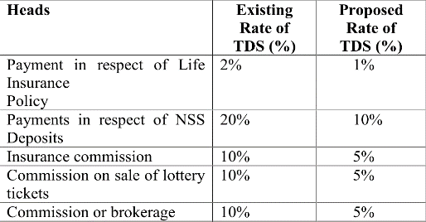

TDS simplification: decrease the % rates, min. ceilings
Budget 2016:
Within India
ECB, Masala Bond, Long term Infra. Bond
“Interest”- TDS (Earlier ~20%, but Post-Budget 2017: 5%)
+ TDS “toughi-fication” to check on tax avoidance.
House rent: 5% TDS if >50k rent per month. (Budget 2017)
Notes:
In order to reduce the compliance burden, it is further proposed that the deductor shall not be required to obtain tax deduction account number (TAN) as per section 203A of the Act. It is also proposed that the deductor shall be liable to deduct tax only once in a previous year.
It is also proposed to provide that where the tax is required to be deducted as per the provisions of section 206AA, such deduction shall not exceed the amount of rent payable for the last month of the previous year or the last month of the tenancy, as the case may be.

Slide 38

TDS Then what’s Tax collection at Source (TCS)
2012: 1% TCS on cash purchase of gold purchase >2 lakh.
Budget 2017: since >2 lakh cash transaction itself is prohibited! So 1% TCS removed.
Showroom owner deposits TCS @IT Department +PAN #
MRP: 15 lakh
1% TCS: 15,000
Client pays: 15,15,000
File IT-return, Get refund.
2016: 1% TCS on cars >10L.

Slide 39
Changing the “Transaction” Habits
2016: SC-SIT on Black Money (Justice MB Shah): “ban cash transactions > 3 lakhs.
2017: Budget: Cash transaction limit: 3 lakh 2 lakh <REF digital payment slides>
Reduced duties on digital payment machines, Micro-ATM, PoS.
Presumptive taxation: more benefits if done via NEFT, Cheque etc... <REF digital payment Lecture>
Budget 2017

Slide 40
Political Funding
What else?
CASH donation to political party: max. Rs. 2k per person. [And if >20k per person- maintain account. Already in RPA]
Counter
1,999/- hence EC wants 20cr. Cap on cash donation.
Budget 2017

Slide 41
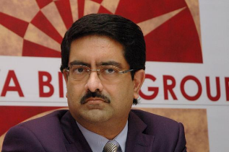
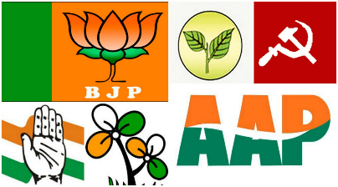
Political Funding in Budget 2017?
BEFORE
Avg. profit 3 years: Max. 7.5% donate
AFTER
No need
No need
Disclose name in account books
Criticism
Shell companies?
Shareholder dividend?
Transparency in election funding ☹
But already, under RPA Act, if >20k donation then party has to maintain record
Notes:
At present, a company may contribute up to 7.5% of the average of its net profits in the last three financial years, to political parties. For this, the company needs to disclose the amount it has contributed to political parties in its profit and loss account. This should also include the name of the political parties to which the company has contributed.
Finance Bill, 2017 proposes to remove the limit of 7.5% of net profit of the last three financial years which a company can contribute to political parties.
It also seeks to do away with the need for the company to disclose the name of political parties to it has contributed.

Slide 42
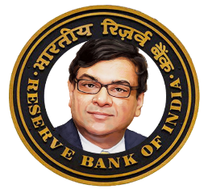
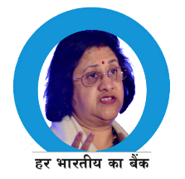
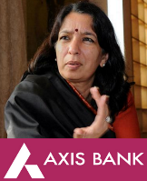

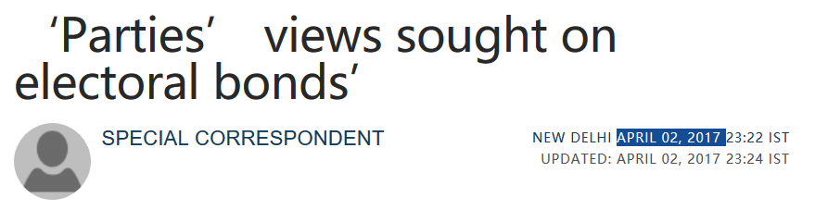

Finance bill 2017: RBI act-> issues Electoral Bond->RPA Act use
Redeem Bond: Money in their bank account
29th May 2017: Jaitley said will announce policy soon. We’ll see in Mains lecture.

Slide 43
Transparency about donations
Chief Minister’s Relief Fund or the Lieutenant Governor’s Relief Fund shall be exempt from tax. Just like PM’s. <earlier they had to formally register and seek exemption>
Charitable inst. Changes work- new registration.
Investor Protection Funds, Tea/Coffee/Rubber Boards, MPEDA, or APDEA; enjoying exemption from levy of income-tax under section 10 of the Income-tax Act shall be required to furnish return of their income.
Budget 2017

Slide 44
Post-demonetization: Budget 2017: Tax administration
Raid without disclosing “tip-source” Even charitable inst. Attach assets for 6 months
NARAM (soften)
KADAK (toughen)
Op-Clean Money: People asked to explain the amt of bank deposits, and high value purchases.
1 page simple tax form for upto 5 lakh income. And if 1st time filing IT-return, then no scrutiny*
Budget 2016
‘e-Sahyog’: to resolve mismatches in Income-tax returns without requiring taxpayers to attend the Income-tax office
Dispute resolution system: reduced penalties, case shut down / withdrawn.
IT & CBEC officers not file appeals @tribunals and HC unless benefit is above __ amount. [reduce litigation]
Discretionary powers of IT officials ▼

Slide 45

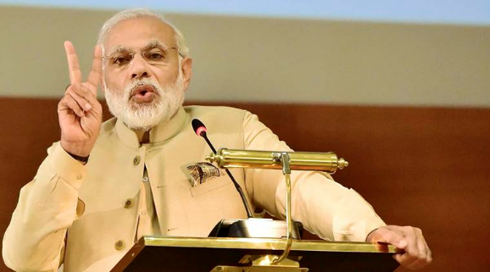
Gyan Sangams for “FI administration”, “Tax Administration”
2015, Pune
Finmin, RBI, Public sector FI
2016, June, Delhi
1st Rajasva Gyan sangam
2016, Gurugram
Finmin, RBI, Public sector FI
CBDT, CBEC top officials.
Modi: RAPID approach: Revenue, Accountability, Probity, Information, Digitization
1st Gyan Sangam (BBB)
2nd Gyan Sangam (Merger of PSBs)

Slide 46
2016: On Tax administration reform commission recommendation
TPRU
disseminate policy papers
Assist Tax Policy Council chaired by FM
Liaise with State Commercial Tax Departments.
The Revenue Secretary will supervise
CBDT and CBEC will give them fiscal/tax topics to do research.
Tax policy research unit
TPC
Tax policy council under FM
Follow-up on reports of Tax Policy Research (TPRU) Unit
suggest broad policy measures for taxation.
The Council will be advisory in nature.

Slide 47
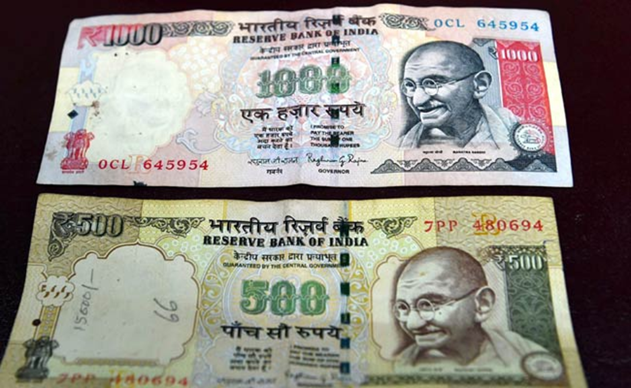
BES172: Budget ► Revenue ► Receipt ► Tax
Recent Acts & Schemes
Tax Admin: TDS, TCS….
Demonetization helped or not?
CGT: root of many problems
BEPS, AEoI
PoEM, GAAR [WEF1/4/17], AAR
Electoral-Bonds
Uniqueness
Then is it a failed experiment?
Security Features
Soil Rate?
How did 97% returned?
Short Term challenges Long term Benefits?

